Slide 1


Vehicle Number Plate Recognition EC-445 Group Project - III
Dept. of Electronics & Communication
Made by: Ishan Patel (17EC053)
Amartya Singh (17ec088)
Rahul Thakkar (17EC094)
Guided By: Mr. Hardik P. Modi
Assistant Professor,
CSPIT-EC.

Slide 2
Contents
What is Digital Image Processing and why is it needed.
Advantages of Digital Image Processing
Disadvantages of Digital Image Processing
Working Of project
Functions Used in Project
Use case diagram
Applications

Slide 3
WHAT IS DIGITAL IMAGE PROCESSING?
Digital Image Processing means processing digital image by means of a digital computer. We can also say that it is a use of computer algorithms, in order to get enhanced image either to extract some useful information.
Image processing mainly include the following steps:
1. Importing the image via image acquisition tools 2. Analyzing and manipulating the image 3. Output in which result can be altered image or a report which is based on analyzing that image.

Slide 4
Need of digital image processing
It is needed to remove noises in an image.
To restore a noisy or damaged image.
Improvement of pictorial information for human perception.
Image processing for autonomous machine application.
Efficient storage and transmission.
To enhance the image.
To manipulate different contents of image such as brightness, sharpness, contrast, etc.

Slide 5
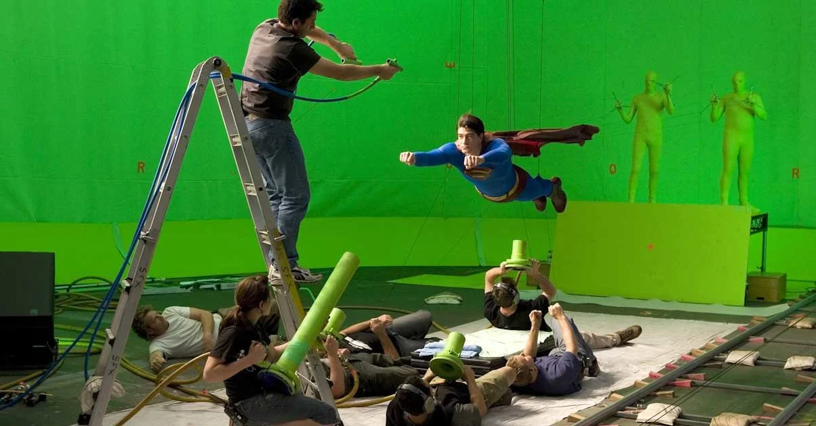
ADVANTAGES OF DIGITAL IMAGE PROCESSING
Digital images can be processed by digital computers.
Important features such as edges can be extracted from images which can be used in industry.
Images can be given more sharpness and better visual appearance.
It allows industries to remove defective products from the production line.
Minor errors can be rectified.
Image sizes can be increased or decreased.
Images can be compressed and decompressed for faster image transfer over the network.
Images can be automatically sorted depending on the contents they have.
Unrecognizable features can be made prominent.
Images can be smoothened.
It allows robots to have vision.
It allows weather forecasting.
It is used to analyze cells and their composition.
It is used to analyze medical images.

Slide 6

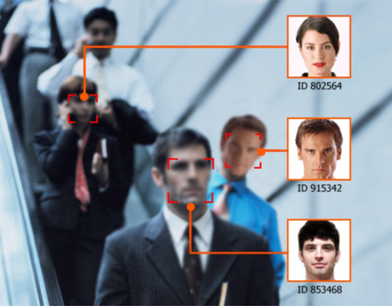

Disadvantages of Digital Image Processing
Misuse of copyright is now easier than it earlier was.
Work has become more technical, which may not be a disadvantage for everyone.
Can be used in unwanted surveillance.

Slide 7
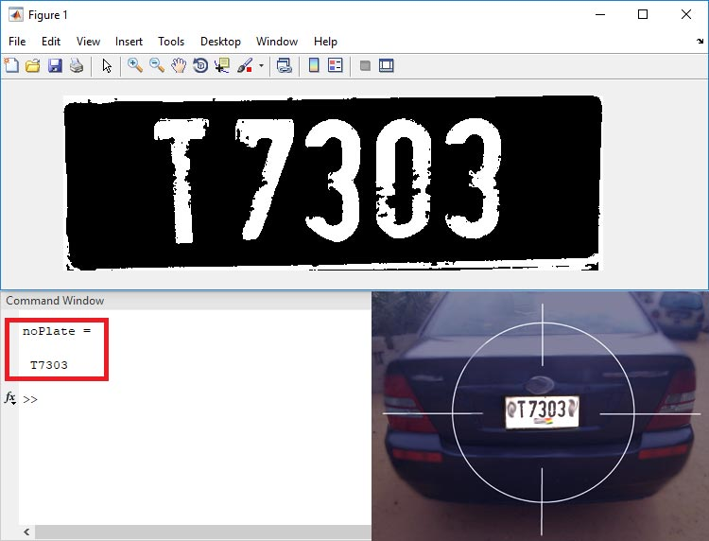
Working of project
The camera of the system captures image of vehicle license plate and then the image is processed through multiple number of algorithms to provide an alpha numeric conversion of the image into a text format.
This system is used at many places like Petrol Pumps, Shopping Malls, Airports, highways, toll booths, Hotels, Hospitals, Parking lots, Defense & Military check points etc.

Slide 8
BLOCK DIAGRAM
Vehicle
Camera
Image Acquisition
Plate Segmentation
Character Recognition
Output

Slide 9
STRUCTURE OF PROGRAM FILES AND ITS USES
There are three programs or ‘.m’ files for this project.
Template Creation (template_creation.m)– This is used to call the saved images of alphanumerics and then save them as a new template in MATLAB memory.
Letter Detection(Letter_detection.m) – Reads the characters from the input image and find the highest matched corresponding alphanumeric.
Plate Detection(Plate_detection.m) – Process the image and then call the above two m-files to detect the number.
Template_creation.m
Output
Plate_detection.m
Letter_detection.m

Slide 10
FLOW CHART
Start
Input Image
Pre-Processing
Image Segmentation
Character & Number Recognition
Display Output
Stop

Slide 11
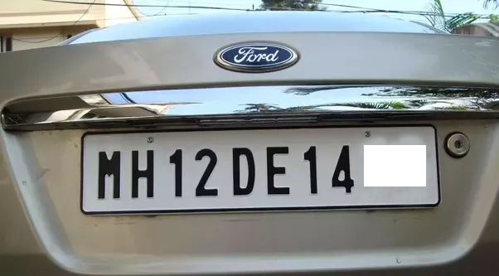
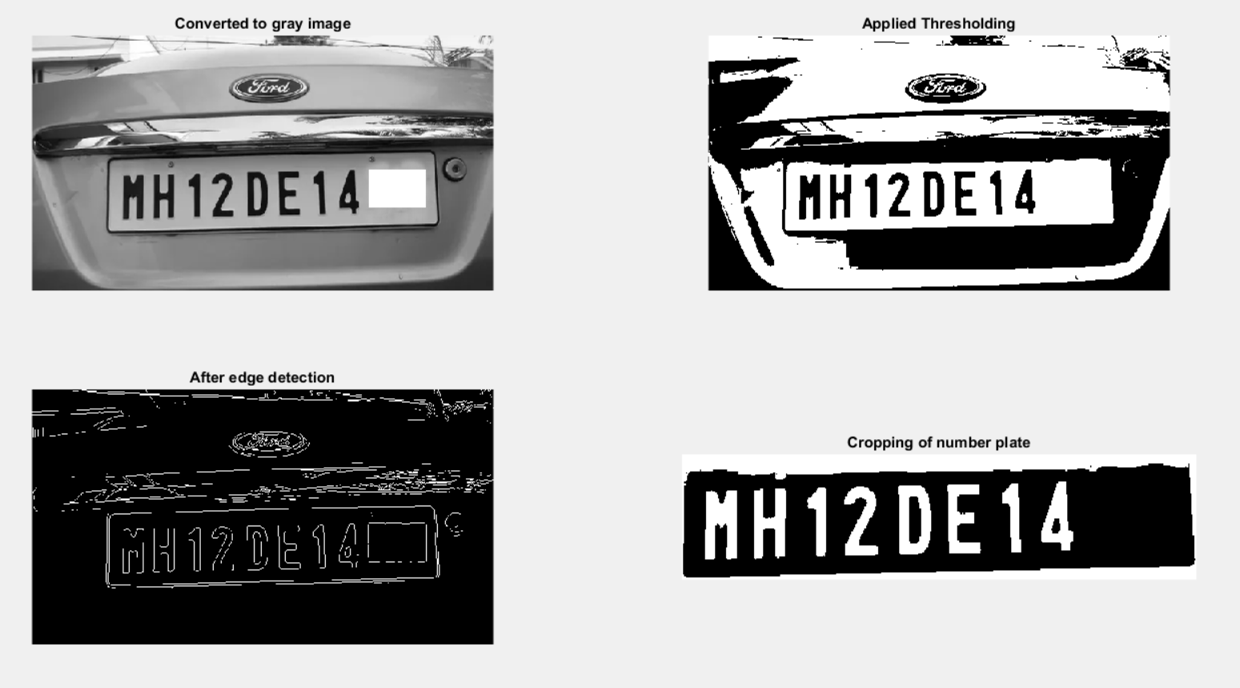

INPUT IMAGE
OUTPUT

Slide 12
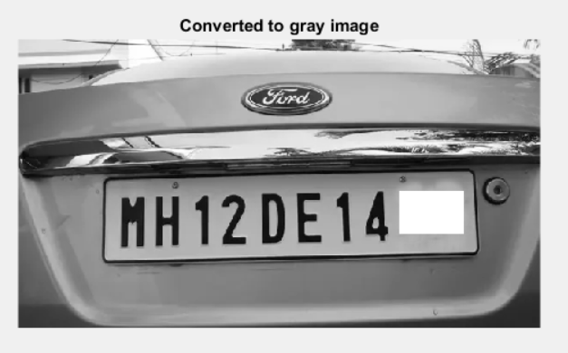
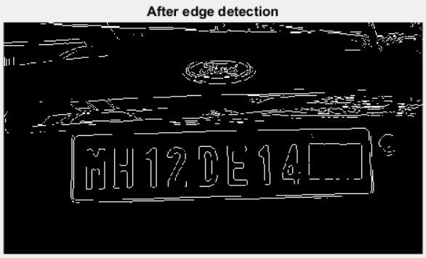
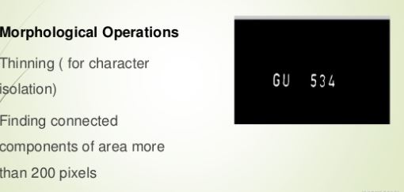
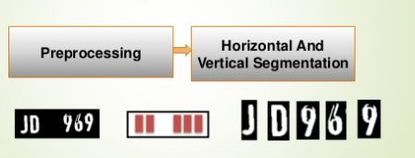
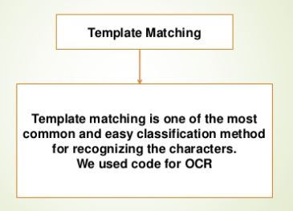
Load the Image from file
Converting RGB image to gray
Edge Enhancement

Slide 13
Functions
imread() – This command is used to open the image into the MATLAB from the target folder.
rgb2gray() –This command is used to convert the RGB image into grayscale format.
imbinarize() – This command is used to Binarize 2-D grayscale image or simply we can say it converts the image into black and white format.
edge() – This command is used to detect the edges in the image, by using various methods like Roberts, Sobel, Prewitt and many others.
regionprops() – This command is used to measure properties of image region.
numel() – This command is used to calculate the number of array elements.
imcrop() – This command is used to crop the image in the entered size.
bwareaopen() – This command is used to remove small objects from binary image.
By using the above commands in the code, we are calling the input image and converting it into the grayscale. Then the grayscale is converted into the binary image, and the edge of the binary images is detected by the Prewitt method.

Slide 14
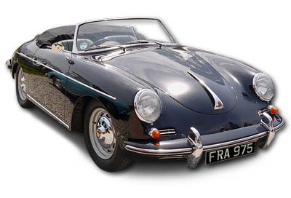
Use Case Diagram
On detection of Vehicle sensor activates the camera
Sensor
Camera
Sensor detects the Vehicle
Image Captured
Image Processing
Find Plate Region
Plate Extraction
Segmentation
Entry in registry
Checking with data base
Recognition

Slide 15
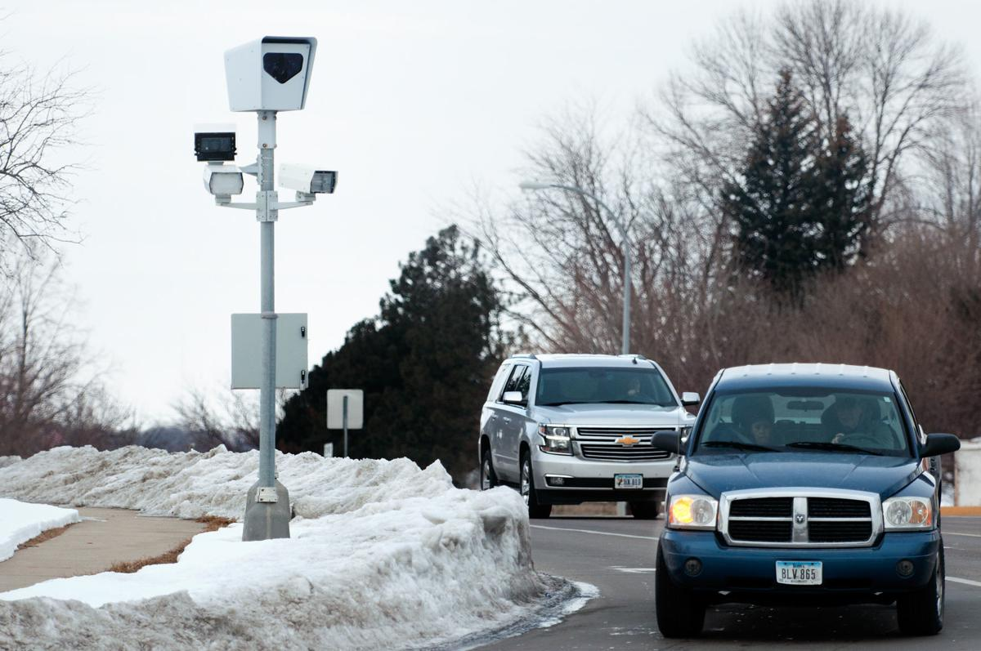
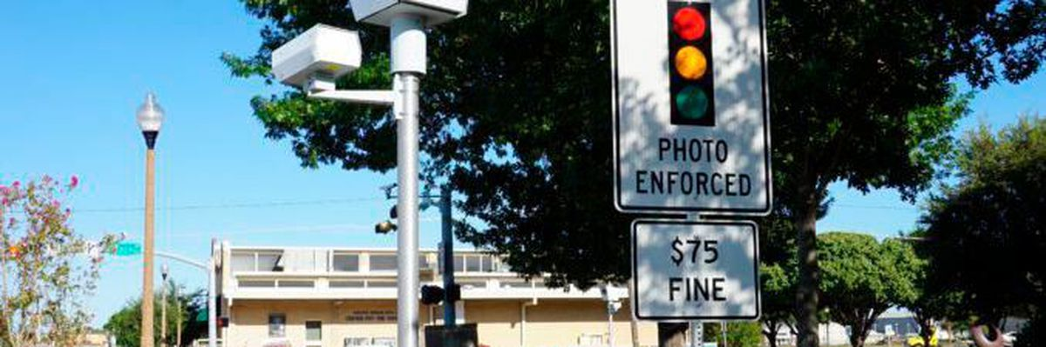
Applications
Parking
Red Light Violation Enforcement
Access Control
Border And Customs Checkpoints
Journey Time measurement
Smart Parking System Management
Detection Of Invalid Licence Plates

Slide 16


